Slide 1







Referansearkitekturer for
Informasjonsutveksling
Sikkerhet
02.04.18
1
1
1
Notes:
Gjennom samarbeid på brukers premisser får vi til deling av data

Slide 2
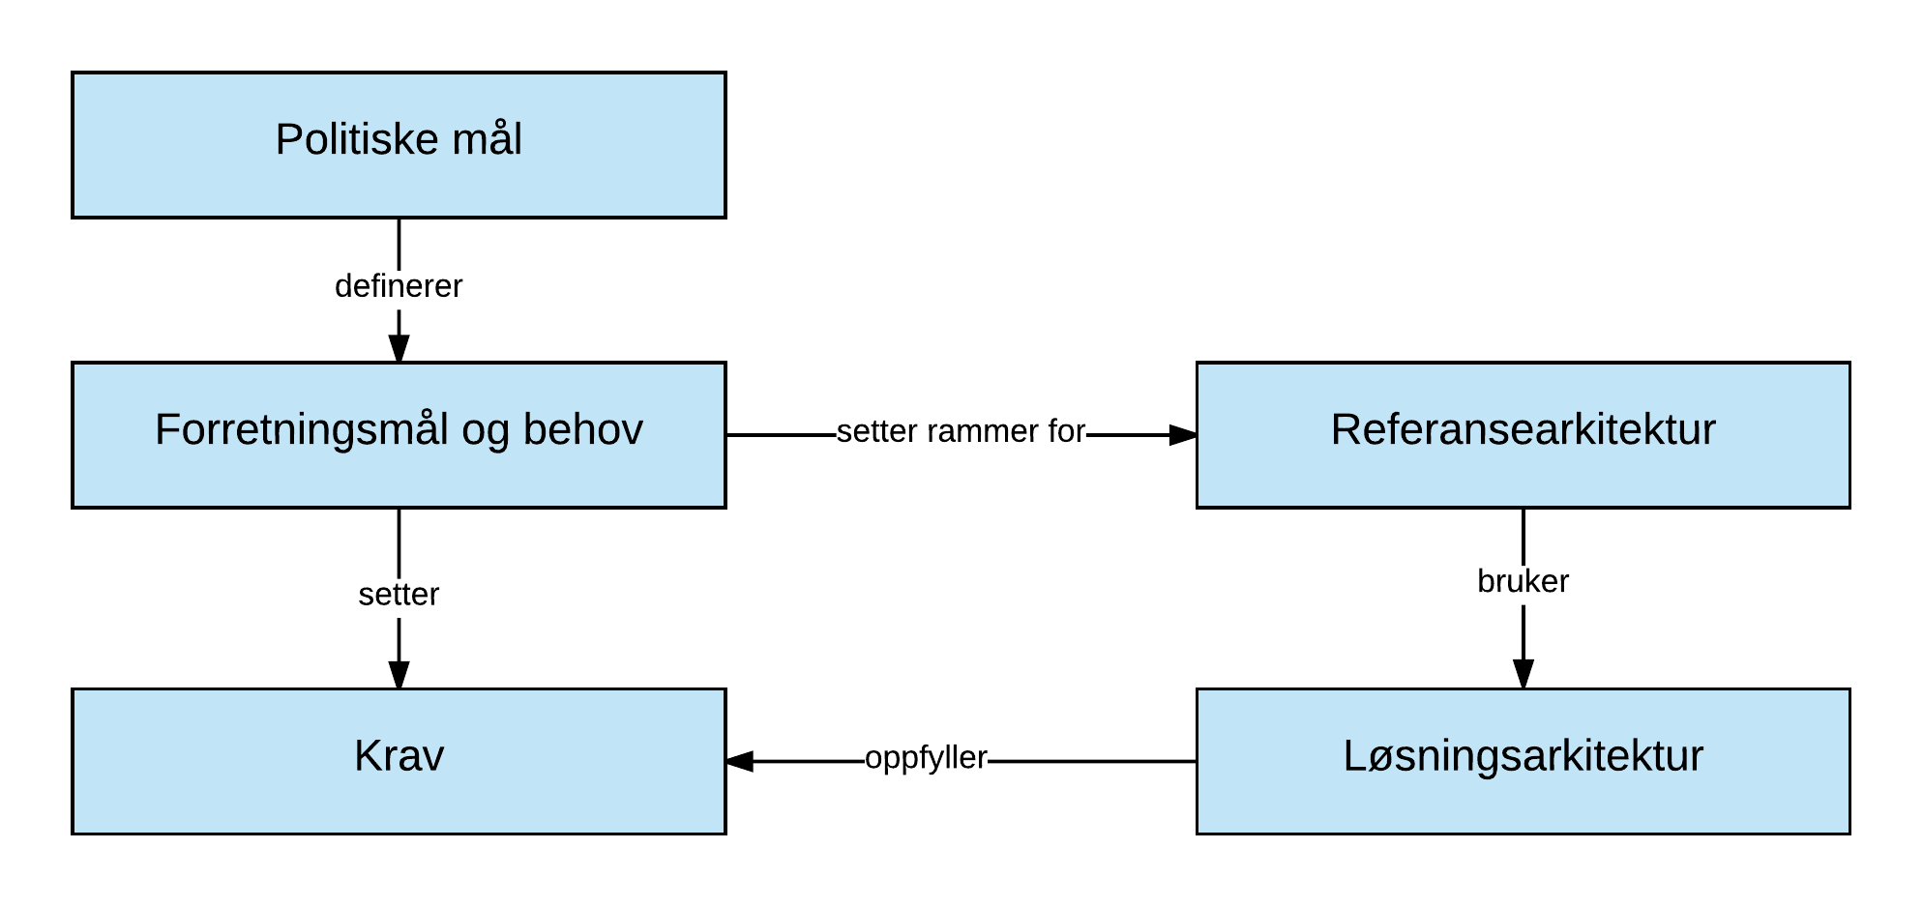
Referanse arkitektur

Slide 3
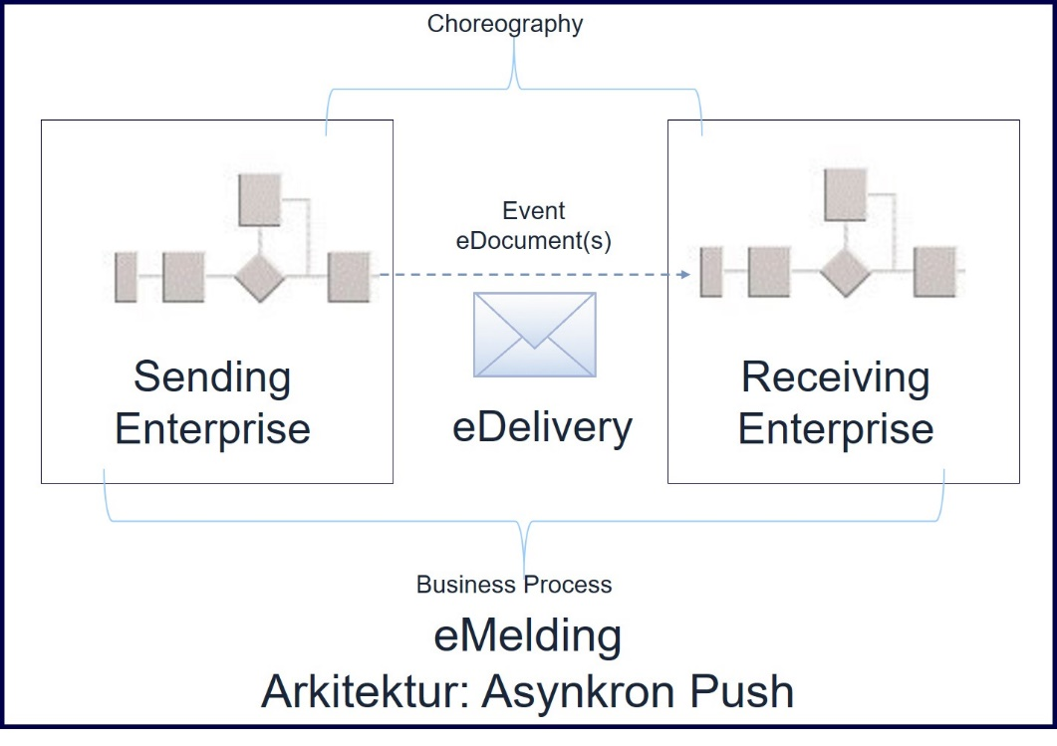
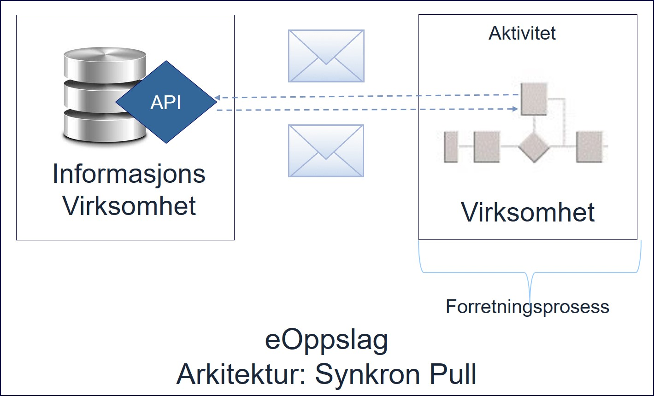
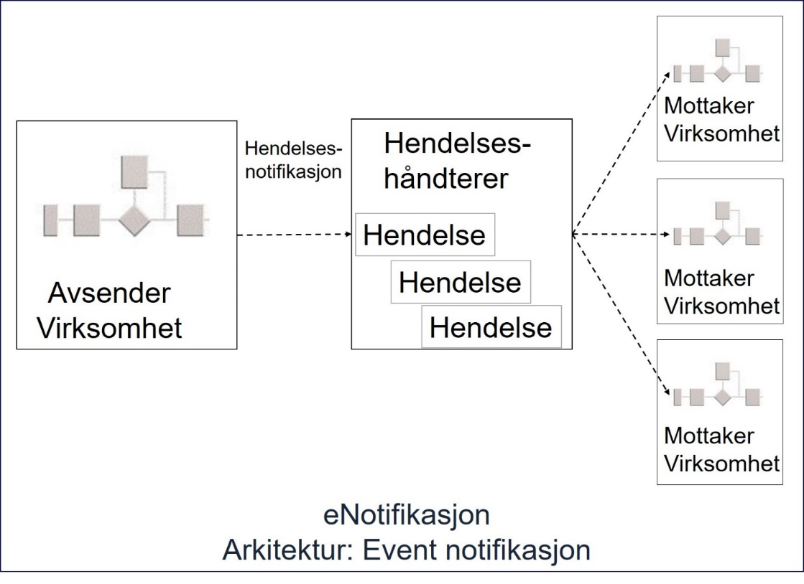
Mønstre

Slide 4
Architectural Building Block
Description
Requirements
Specification
Archimate tegning
Architectural Description
Profile
Standard(s)
Recomendations
Work-in-Progress
References

Slide 5
Overordnet
Uavviselighet
??
Sikkerhet (Hemmeligholdelse)
?? (evt. se AS4)
«Bruker» styring
Sikkerhet (Autencitet, Autorisasjon)
XACML
oAUTH
SAML
Integritet
ID-porten
Virksomheter??
Autorisation
Virtual community
Utvekslingsmåte
Webservice (WS-*, AS4)
REST (HTTP)
oData: http://www.odata.org/
Dansk referansearkitektur
Samtykke
API/Service
Konsument
API/Service
Tilbyder
Utvekslingsformat
XML
JSON
Hypermedia:
https://open-services.net/
HATEOAS
Publishing fra API/Service tilbyder
??
eNotifikasjon ved endringer
Tjeneste utvikling (design time)
Run time support tjenester
Begrebs katalog
Data katalog
API
katalog
Capability
LookUp/ SMP
Business Certificate Publisher
Security
Token
Service
SKOS
DCAT
Open API
oData????
OASIS SMP
??
??

Slide 6
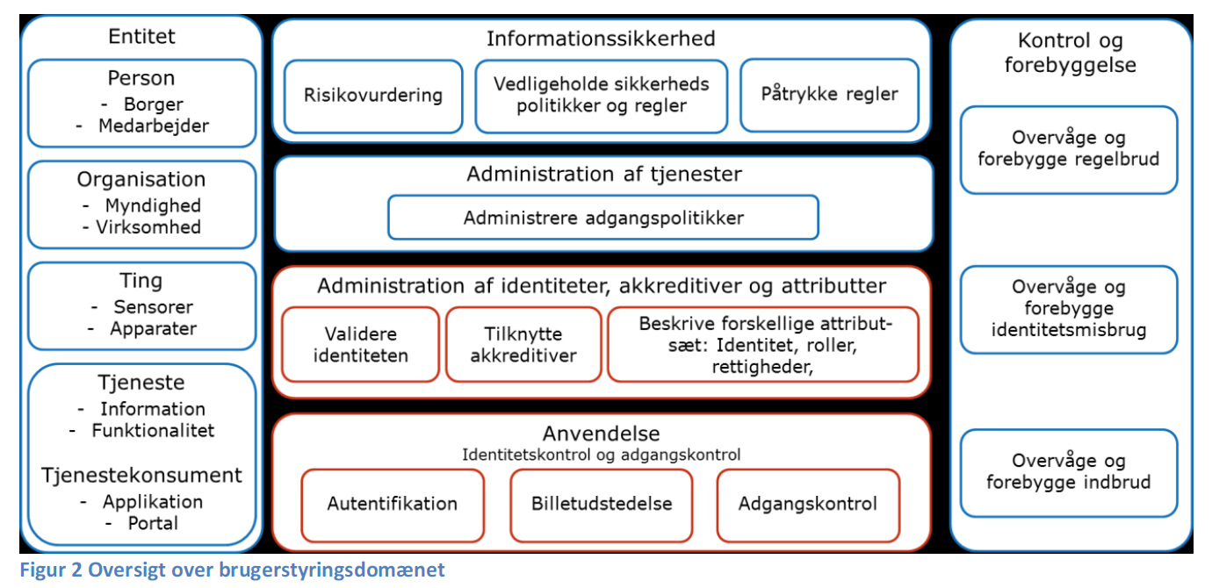
Rammeverk

Slide 7
Threats
Normal
Interruption
Interception
Modification
Fabrication
Uauthorized
?

Slide 8
API access
Authenticity
Authorization
Access Policies

Slide 9
Vulnerability
Secrecy – Sender/Receiver Confidentiality of message
Integrity – Message can only be manipulated by sender and/or receiver
Authenticity– Sender and receiver can be validated
Non repudiation– Neither sender or receiver can question the Authenticity or Integrity of the message i.e. the message has been send and received by the participants, and the message has not been changed.
Authorization – Only accessebility to granted access rights/privileges to resource

Slide 10
Secrecy
Secrecy – Sender/Receiver Confidentiality of message
Encryption
Symmetric key
TLS (Transport Layer Security) – Basic Secrecy
Asymetric key
Using Receiver Public key and Sender Private key (certificate from Busienss Certificate Publisher)
X509
XML encryption
JSON ?

Slide 11
Integrity
Integrity – Message can only be manipulated by sender and/or receiver
Encryption
Symmetric key
TLS (Transport Layer Security) – Basic Integrity
Asymetric key
Using Sender Private key (certificate from Busienss Certificate Publisher)
X509
XML encryption
JSON ?

Slide 12
Authenticity
Authenticity– Sender (and receiver) can be validated
Digital signature
Using Sender Private key (certificate from Busienss Certificate Publisher)
Using certificate from ID-porten
OpenID
X.509
XML encryption
JSON ?
Entities
Person
Organization
Thing
Service

Slide 13
Non-repudiation
Non repudiation– Neither sender or receiver can question the Authenticity or Integrity of the message i.e. the message has been send and received by the participants, and the message has not been changed.
Message choreography
Sender sends message (including timestamp) with Authenticity, Integrity.
Receiver returns receipt ((including timestamp) with Authenticity, Integrity.
Timestamp
Receipt

Slide 14
Authorization
Authorization – Only accessebility to granted access rights/privileges to resource
Acces rights/privileges
Ticket
Authorization server
SAML
Oauth
Access Policy

Slide 15
Fuldmagt
?

Slide 16
Kerberos – Single Sign-on
Ticket Granting Server (TGS)
E(TGS session key, (Service key, E(TGS-Service key, (Service Ticket))))
E(TGS session key, (Service access request, E(TGS-AS key, TGT ticket)))
Client
Service
E(Service key, (Service Request, E(TGS-Service key, (Service Ticket))))
UserId
E(Password, (TGS session key, E(TGS-AS key, TGT ticket) )
Authentication Server
(AS)
E(TGS-AS key, (TGS session key, TGT ticket))

